Slide 1
The
Operating Systems Curriculum
[Loading...]
20xx
</
} /> [
/>
By DIGITAL

Slide 2
Commentary
Dear Future OS Members,
Most, if not all, of the code shown in this curriculum is pseudocode or Jack language meant to simplify the explanation of how operating systems work. Your operating systems are more complex and require the relevant libraries, function calls, subroutines, and recognized commands in their respective language. Conduct research on the intricacies of your chosen language when writing your code.
Sincerely,
The OS Team

Slide 3
Directory
Concept of Memory | Slide 3
Segmentation
Memory Virtualization
Optimization
Virtual Machine | Slide 30
Quick Compiler Intro
Stack Machine
VM Emulator
Branching Commands
Function Commands
Compiler | Slide 60
Writing a Compiler
Syntax Analyzer
Lexical Analysis
Grammars
Parsing
Code Generator
Procedural Code
Handling Objects
Handling Arrays
Standard Virtual Machine Mapping
Operating System | Slide 103
Efficiency
Memory Access
Heap Management
Graphics
Textual Output
Input
String Processing
Array Representation
The Sys Class

Slide 4
01
Concept
Pitch Deck
20xx
</>
} /> [

Slide 5
Concept of Memory
Pitch Deck
20xx
</
/>
} /> [
Stored Data

Slide 6
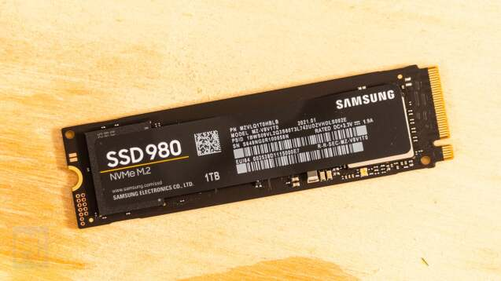
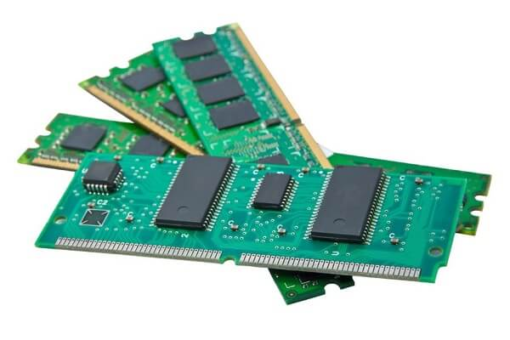
What is Memory?
The part of a computer that provides temporary storage for data and instructions that the CPU needs to access quickly.
Memory is necessary for computers to load the operating system, perform all functions, and run computer processes.

Slide 7
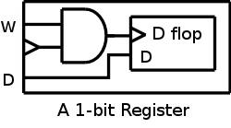
How is Memory Stored?
Bit Registers
Small, very fast storage location inside a CPU. It is made of flip-flops, each of which can hold 1 bit of information (a 0 or a 1)
Clock inputs determine the state of the register, such as when it is time to store data or send/release data.
Multi-Bit Registers
Combined, these registers can store binary code, which allows devices to send more intricate signals during communication.

Slide 8
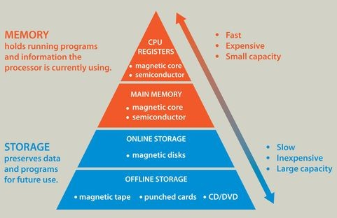
Types of Memory Storage
Primary - faster memory recall, but much lower in capacity
Random Access Memory (RAM)
  Temporarily holds data and instructions that the CPU is currently using
  Volatile memory (loses data when power is off)
Read-Only Memory (ROM)
  Stores permanent instructions needed to start the computer
  Non-volatile memory (does not lose data when power is off)
Secondary - slower than primary, but much larger in capacity
Hard Drive (HDD)
Solid-State Drive (SSD)
Universal Serial Bus (USB) Flash Drive
Compact Disc (CD)
Two other types of memory we will cover: Cache & Virtual

Slide 9
Segmentation
Pitch Deck
20xx
</
/>
} /> [
Memory Management Schemes

Slide 10
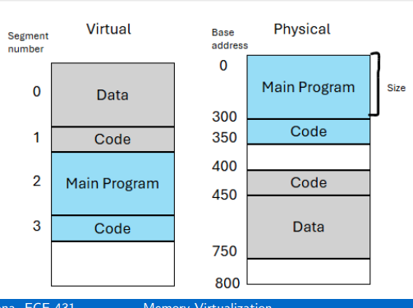
What is Segmentation?
A memory management scheme where a process’s memory is divided into variable-sized segments.
Each segment is defined by a base address (beginning of segment) and a size (limit of segment).
Virtual Address = A segment number (id of segment you want to access) + offset (where in the segment we want to access)

Slide 11
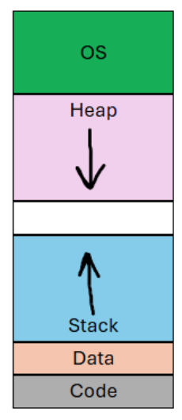
Types of Segmentation
Code - Executable instructions of a program
Data - Global and static variables
Heap - Used for dynamically allocated memory (grows upward)
Stack - Used for function call management such as local variables, return addresses, and function parameters (grows downward)

Slide 12
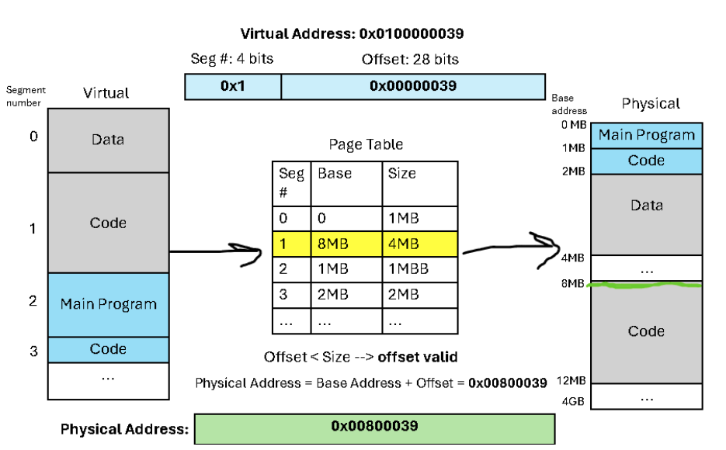
How Does Segmentation Work?
Segments are separated in a segment table. The segment table maps virtual segment to their corresponding physical segment.
Steps:
MMU uses segment table to look up base address and size of physical segment desired
MMU checks whether offset is within the segment’s limit
If Valid:
Physical Address = Base Address + Offset
If Not Valid:
Segmentation Fault Occurs
MMU* - Memory Management Unit
Links virtual VM addresses to physical RAM addresses
More to be said later on!
Segment Table

Slide 13
Problems with Segmentation
External Fragmentation
When free memory space is broken into small, non-contiguous blocks, there is not enough space for a large, contiguous block.
Complex Allocation
More complex logic is required because the OS has to search for contiguous blocks that are large enough to allocate in RAM, or the OS may even have to reorganize the entire RAM in order to create contiguous blocks of free space.
Limited Growth Flexibility
Even though segments can grow through the stack or heap, it won’t even matter if there isn’t enough space for the segment to expand.
Disk Limitations
Less suitable for utilizing disk storage since this too would be organized in segments and would end up having the same issues as the RAM.

Slide 14
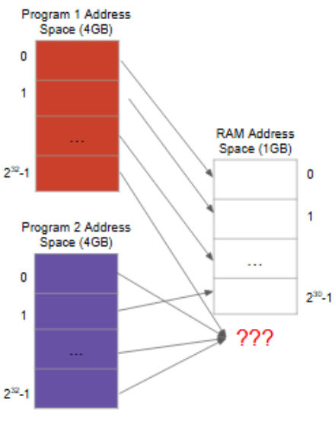
Memory Problem #1
Insufficient RAM Space
Users always want more processes + Processes demand more resources from RAM = Never enough RAM

Slide 15
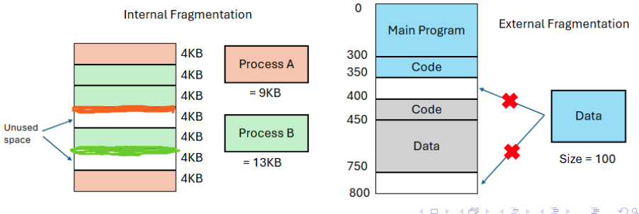
Memory Problem #2
Memory Fragmentation
Internal Fragmentation: Allocated memory exceed needed memory; unused space
External Fragmentation: Free memory is not continuous, but scattered across different bits; Large allocations cannot fit in small space or divide among scattered bits

Slide 16
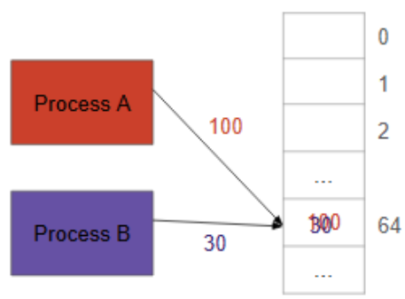
Memory Problem #3
Process Security
Different processes access the same address register, corrupting one another’s data

Slide 17
Solution
Virtual Memory
A system that allows processes to behave as if they have a large, continuous block of memory, even if the actual physical memory is small or fragmented.
Memory Protection
Protection against corrupting and overwriting data
Efficient Resource Sharing
Removal of scattered bits and optimizing of space
All of these techniques are handled by the Memory Management Unit (MMU). The operating system (OS) relies on the MMU to perform these actions so that the OS can translate virtual addresses into physical addresses for the computer’s hardware.

Slide 18
Memory Virtualization
Pitch Deck
20xx
</
/>
} /> [
The Concept

Slide 19
What is a Memory Management Unit (MMU)?
A crucial component of the CPU that automatically translates virtual memory addresses into physical memory addresses used in the RAM.
The bridge between software memory and hardware memory
Also controls:
Cache - small, fast memory that stores copies of frequently accessed data
Translation Lookaside Buffer (TLB) - a collection of memory caches that stores the recent translations of virtual memory addresses to physical memory addresses
Page Faults - exceptions which occur when a program tries to access a memory page not present in the RAM

Slide 20
What is an Operating System (OS)?
A software system that manages computer hardware and software resources.
Main Task:
Allocate Resources
Memory
CPU Usage
Input/Output Devices
File Storage
User Accounts

Slide 21
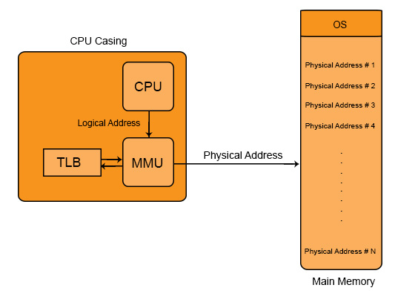
What does MMU and OS do together?
Process Isolation
An OS feature that protects processes from interfering with each other by providing each with its own dedicated memory and execution environment
Efficient Memory Use
Minimize wasted computer memory (RAM) to improve overall system performance, resource utilization, and stability
Allows Programs to Run Even Without Enough Physical RAM
By using virtual memory, data can be saved on pages and swapped in and out the RAM depending on how often the page is used.

Slide 22
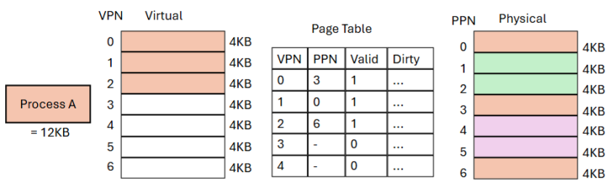
Solution
Paging - a memory management scheme that eliminates the need for contiguous memory allocation required with segmentation
Divides both physical and virtual memory into fixed-sized blocks called pages
Effect:
Virtual and physical pages are the same size
Pages occupy a whole process, multiple processes, or parts of a process depending on size of process

Slide 23
Page Table
A data structure that holds all the pages and marks each page as their own page table entry (PTE).
The page table is stored physically. The MMU breaks down virtual addresses and uses the page table for address translation.
Flags prevent overwriting data.
Flag Types:
Valid - entry is usable
Dirty - page has been written into

Slide 24
Combined Implementation of Segmentation & Paging
The virtual address contains these two elements:
Virtual Page Number (VPN) - the page in virtual memory we want to access
Different from the more commonly-known VPN (Virtual Private Network)
Offset - the specific byte we want to access
The physical address contains two elements:
Physical Page Number - indicates page in physical memory we want to access
Offset - the specific byte we want to access (offset remains the same because virtual and physical page size is the same
Process:
The MMU gets the PPN by using the VPN to index into the page table, which stores virtual-to-physical page mappings
The offset is directly copied from the virtual address to the physical address.

Slide 25
Optimization
Pitch Deck
20xx
</
/>
} /> [
Multi-Level Madness

Slide 26
The Drawbacks of Single-Level Paging
Extremely large size, which requires a significant amount of physical memory
Internal Fragmentation
Slower than accessing RAM

Slide 27
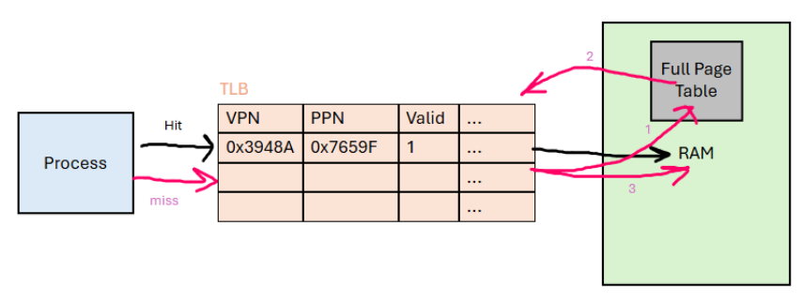
What Does Cache Do?
Problem:
Accessing the page table from RAM after every memory access is both time-consuming and costly.
Solution:
Systems use cache to store recent table page lookups for faster translation

Slide 28
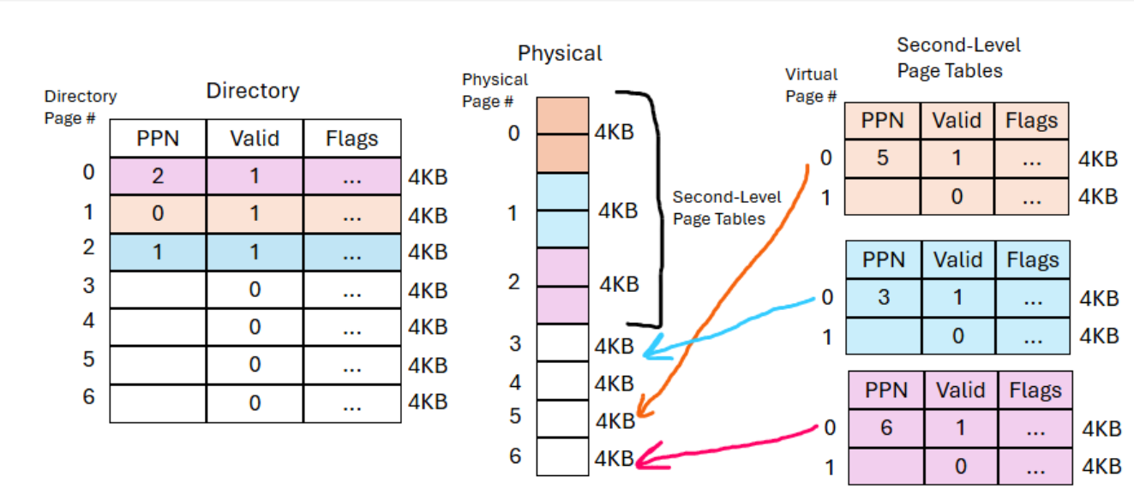
How Does Multi-Level Paging Help?
Allocation Speed
Systems only need to allocate page tables that are actually needed rather than the entire page table
Memory Footprint
Systems can move page tables out of the RAM and into the disk to save space if the page table is not actively used

Slide 29

End of Meeting #1
[Loading...]
20xx
</
} /> [
Do you have any questions?
/>
Thanks for attending!
OS Team

Slide 30
The
Operating Systems Curriculum
[Loading...]
20xx
</
} /> [
/>
Pt. 2 | Virtual Machines

Slide 31
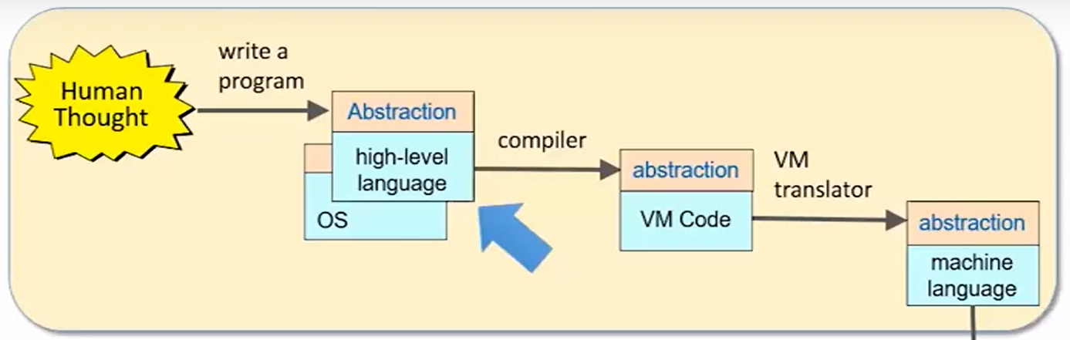
Visualization
Operating System → Compiler → Virtual Machine

Slide 32
Quick Compiler Intro
Pitch Deck
20xx
</
/>
} /> [
Communication Between Human and Computer

Slide 33
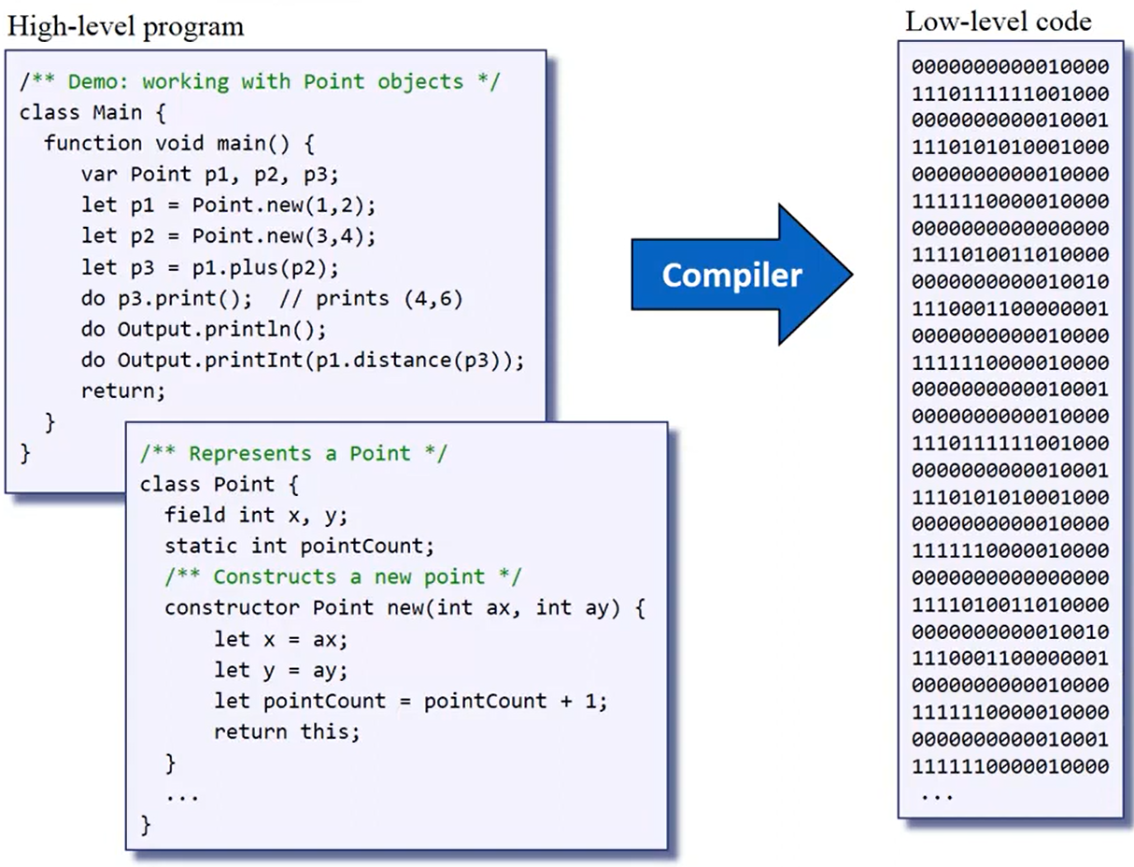
Compilers
Compilers high-level programming to low-level code
High-Level Programming: Designed specifically to be user-friendly for humans to interpret and understand what is going on
Low-Level Code: Programming languages that are closer to the computer's hardware and provide direct control over its resources

Slide 34
Two Implementations
Cache
Small, fast memory that stores copies of frequently accessed data to speed up future access
Multi-Level Paging
A memory management technique that replaces a single, large page table with a hierarchy of smaller page tables

Slide 35
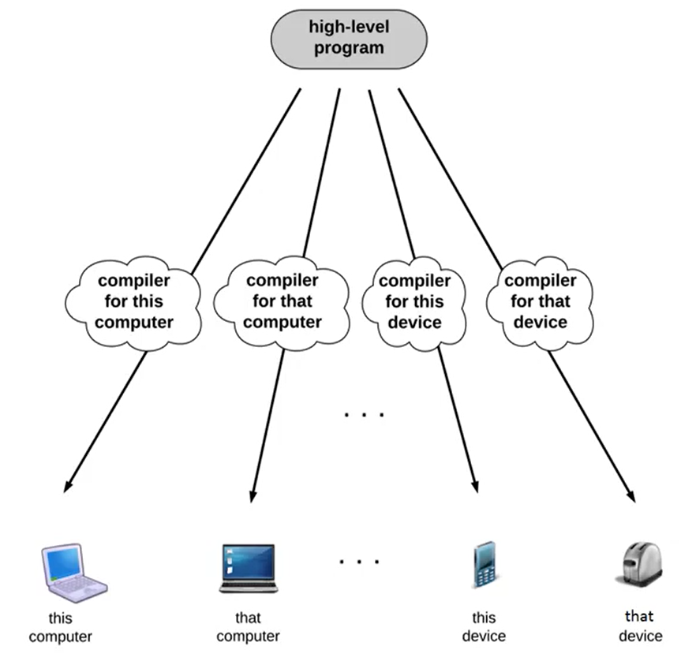
Problems with Compilers
Many devices use different processes and machine languages
You are forced to write MULTIPLE compilers for each processor
You are forced to translate your program across many platforms and maintain multiple version of your code

Slide 36
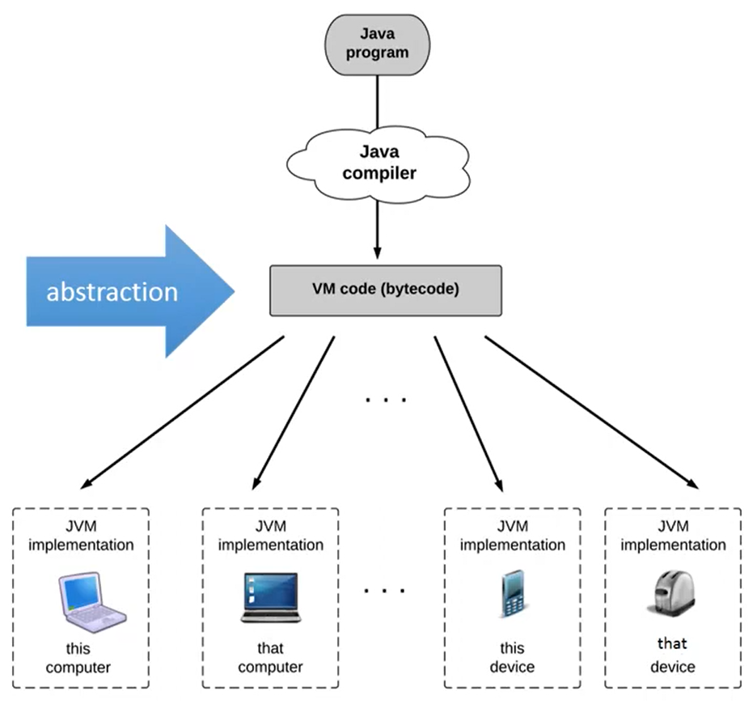
Solution: Two-Tier Compilation
Do not compile program down to machine language
Instead, program is translated into VM Code through
Two-Tier Compilation
Allows you to Write ONCE, Run ANYWHERE
Tier I: Virtual Machine
VM Code is a set of instructions for the VM that is understood by any VMI (universal)
Tier II: Virtual Machine Implementation
Equips target device with a translation to convert VM code into machine language for a specific device

Slide 37
Virtual Machines
Pitch Deck
20xx
</
/>
} /> [
The Bridge to Universal Language

Slide 38
What is a Virtual Machine?
A Virtual Machine is software that emulates a real computer system. It uses virtual representations of the host’s physical resources, managed by the hypervisor, rather than accessing the physical hardware directly.
Consists of:
Host: a physical computer
Guest: the operating system running in the VM
Hypervisor: the software that manages VM by mapping virtual resources to real resources

Slide 39
What is a Virtual Machine Equipped With?
VM Code
Think of it as “intermediate” code.
This code acts as a middle-ground the source code and the assembly code.
VM Translator
Receives a stream of VM commands to convert VM code into assembly code that contains assembly commands
Translates VM code into machine language
Each VM command generate several assembly commands

Slide 40
Stack Machines
Pitch Deck
20xx
</
/>
} /> [
Optimizing VM Translation

Slide 41
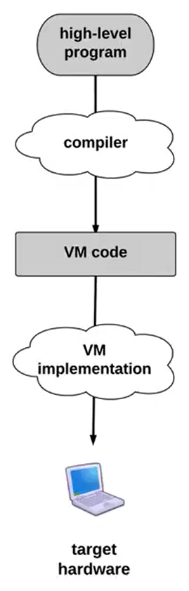
Problem
VM Code Objectives:
Simplify VM Compiler: VM Code needs to be closer to high-level so resources needed for translation to get from high-level program to VM code is minimized
Simplify VM Implementation: VM Code needs to be closer to low-level so resources needed for translation to get from VM code to low-level program is minimized
These two objectives contrast one another. How can we get around this?

Slide 42
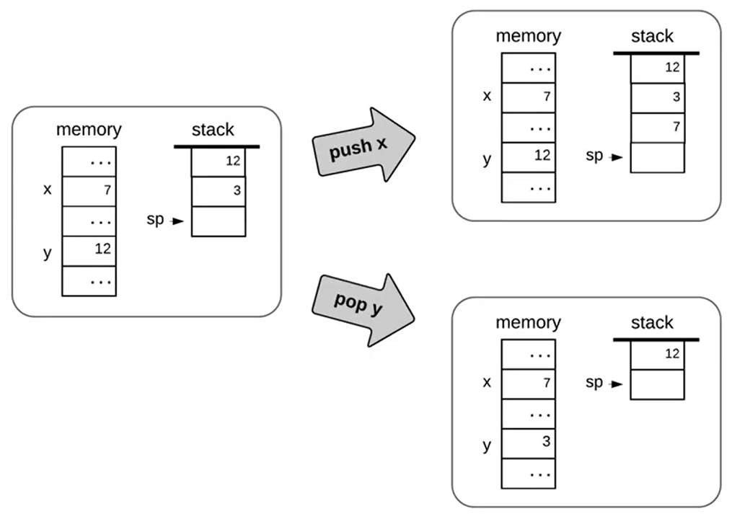
Solution
Stack Machine – a computer architecture that balances the two objectives very well
Two Fundamental Operations:
Push: add a layer to the top of the stack
Pop: remove the top stack layer and store in memory
You can ONLY access the stack’s data from the top layer
Why does this help?
Makes VM code compact and easy to interpret
No need to fetch operands from memory or registers
Helps prevent memory corruption

Slide 43
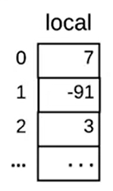

Reading a Stack
Stack Pointer
Points in the register on the top of the stack, usually at an empty register unless the stack is full
(SP)
Base Addresses
Ids that identify which number of the stack corresponds to which layer of data
(0, 1, 2, …)
Integer Data
Data stored within the stack
(7, -91, 3, …)
SP

Slide 44
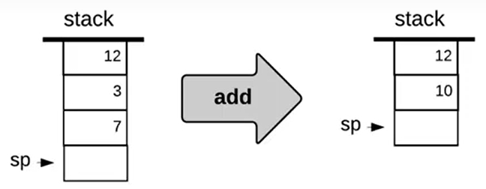
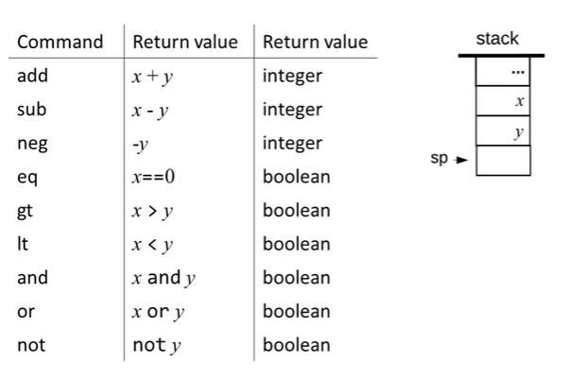
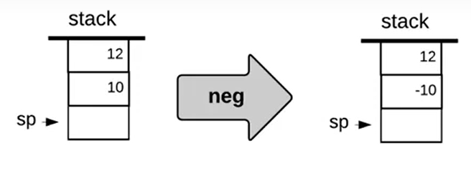
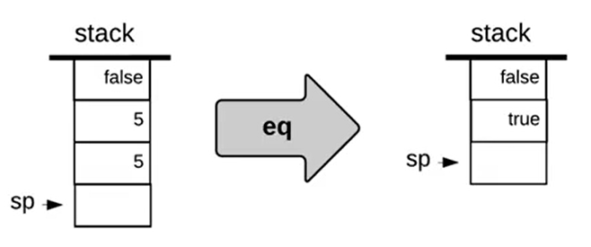
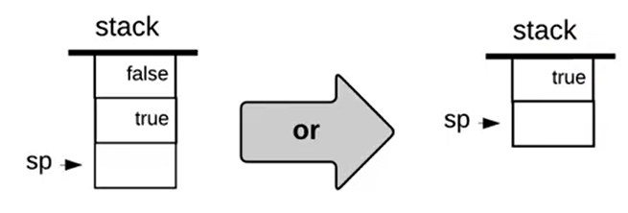
Stack Arithmetic
With just Push & Pop, you can do many logical/arithmetic commands, such as
Using just these commands, we can express ANY arithmetic or logical expression.

Slide 45
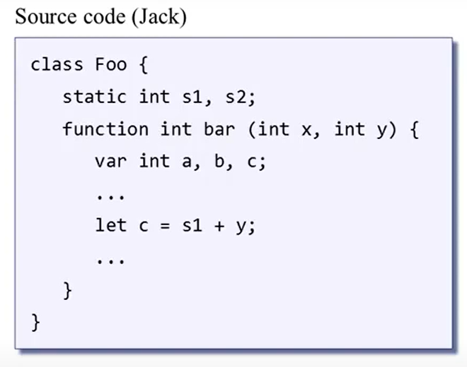
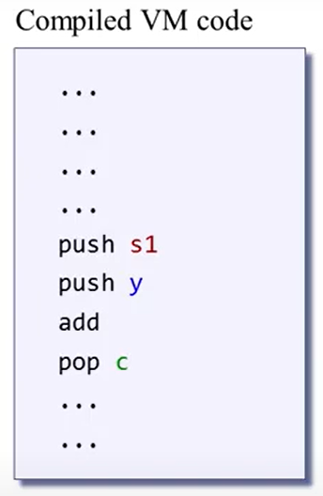
Problem
How do you differentiate between different variable types, such as argument, local, and static?
Push & Pop will treat these variables as the same type, so how do we solve this?

Slide 46
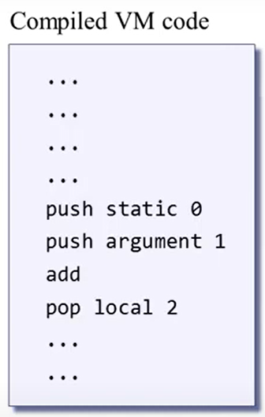
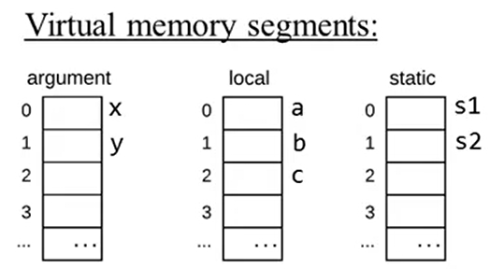
Solution: Memory Segments
Use segments that differentiate the variables.
s1 → static 0
y → argument 1
c → local 2

Slide 47
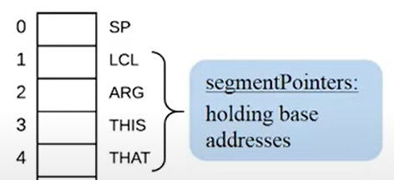
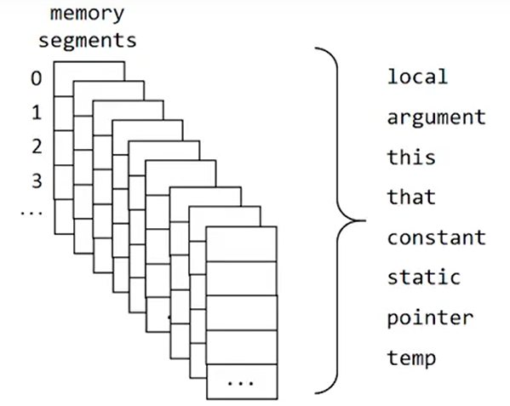
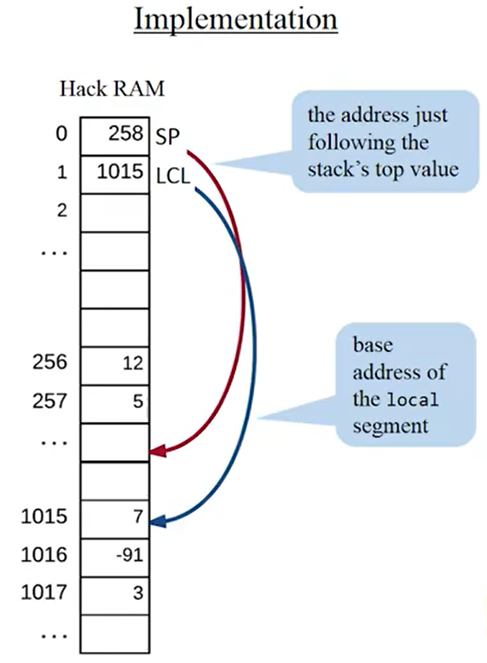
Implementing Memory Segment Pointers
Using the same stack, segment pointers can use the integer data in its pointed stack as an address register, which points to another register’s data point.
Typical Segments Include:

Slide 48
Problem: How Should We Handle Static Variables?
Static Variables (aka Global Variables):
Static Variables are unique in the sense that they exist/are used by all methods in a program.
(why can’t we store static variables the same way we do other variables?)

Slide 49
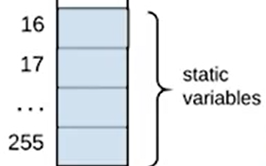
Solution: Static Space
Static space is a universal assignment to each program a certain amount of addresses allocated specifically to static variables to ensure that all programs have space for static variables.

Slide 50
VM Emulator
Pitch Deck
20xx
</
/>
} /> [
Shortcut to Testing VM Code

Slide 51
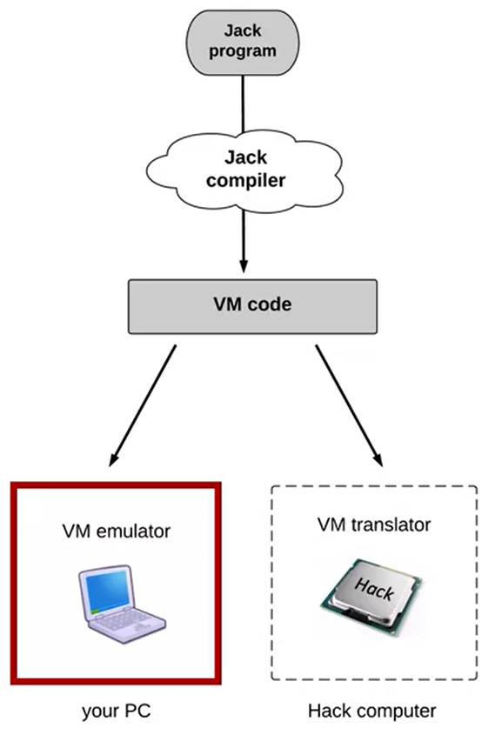
Two Ways to Use VM Code
Original Route:
High-Level Program → Compiler → VM Code → VM Translator → Machine Language
Shortcut:
High-Level Program → Compiler → VM Code → VM Emulator
Allows you to run VM Code as-is (compiled)
Mainly used as an environment to test programs

Slide 52
Branching Commands
Pitch Deck
20xx
</
/>
} /> [
Placeholder

Slide 53
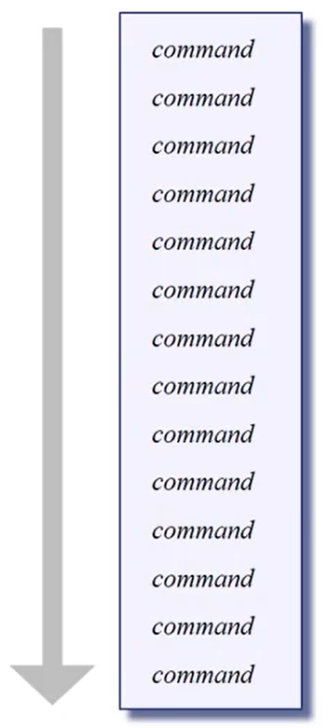
Problem: Linear Programming
Commands are executed after one another.
Takes up more space if commands need to repeat (which modern programs must to do run continuously)

Slide 54
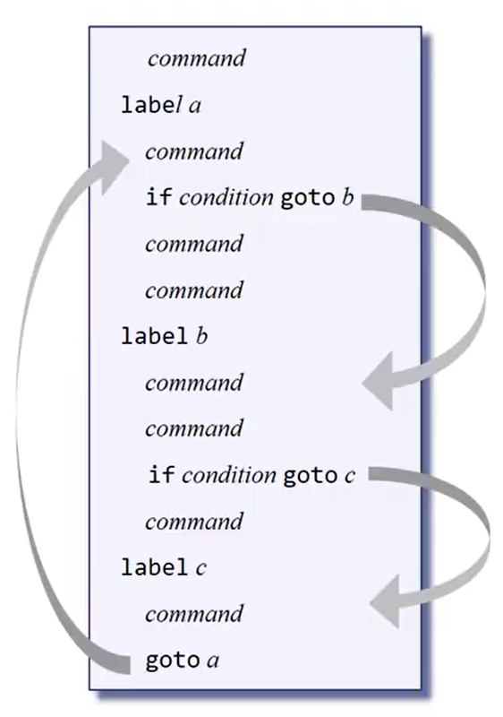
Solution: Non-Linear Program (Branching)
Commands are given conditions that allow them to skip ahead or go backwards, accessing commands quicker or reusing commands. Also allows looping
Conditional Branching (if)
Must meet a certain condition
Unconditional Branching (goto)
A command executed upon being read

Slide 55
Function Commands
Pitch Deck
20xx
</
/>
} /> [
Placeholder

Slide 56
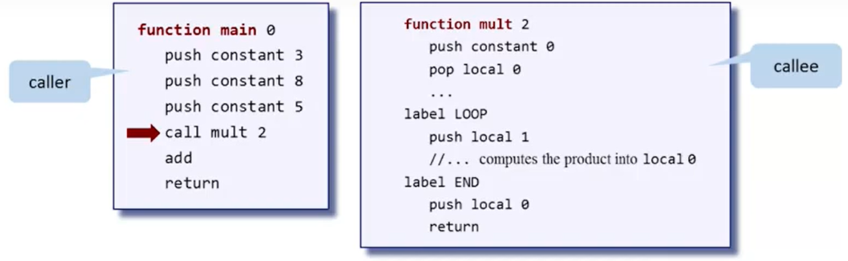
Function Commands
A way of grouping a series of commands into a single, executable unit.
Three Basic Function Commands:
function functionName nVars
call functionName nArgs
return

Slide 57
Problem
The calling chain is not always between just two functions.
One function can call another function, which can call another function, which can call another function,
which can call another function, which can call another function, which can call another function, which can call another function, which can call another function, which can call another function, which can call another function…
How do we maintain the state of all of these functions in the calling chain?

Slide 58
Solution: LIFO
Calling Pattern: Last In, First Out
The only function that can return is the function which is currently running (end of calling chain).
Last Function Returns → 2nd to Last Function Returns —> … → First Function Returns
Hey wait, doesn’t that sound similar to a stack?

Slide 59
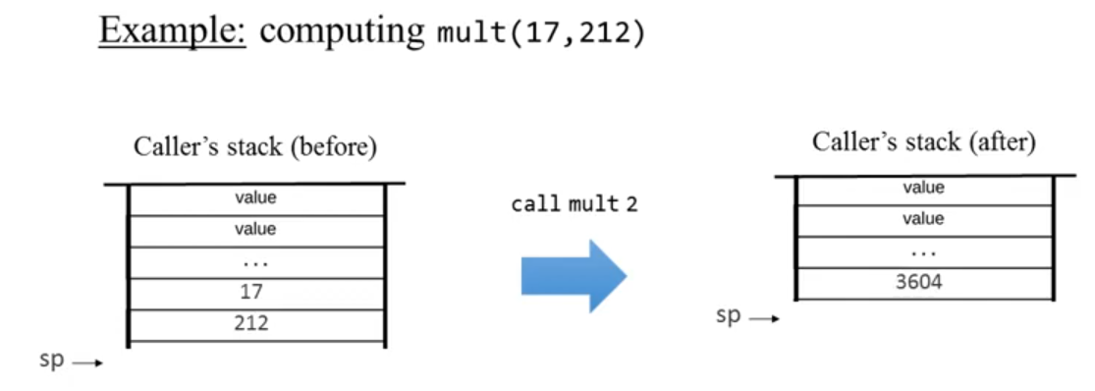
STACKING
Function’s arguments are replaced by the function’s value

Slide 60
End of Meeting #2
[Loading...]
20xx
</
} /> [
Do you have any questions?
/>
Thanks for attending!
OS Team

Slide 61
03
Compilers
Pitch Deck
20xx
</>
} /> [

Slide 62
Writing a Compiler
Pitch Deck
20xx
</
/>
} /> [
High-Level Programming to VM Code

Slide 63
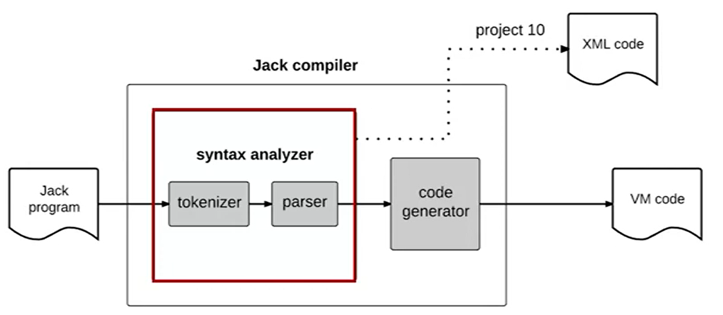

What Will We Learn
Syntax Analysis
Lexical Analysis
Grammars
Parse Trees
Parse Logic
Testing
Compiler
High-level program

Slide 64
Syntax Analyzer
Pitch Deck
20xx
</
/>
} /> [
Placeholder

Slide 65
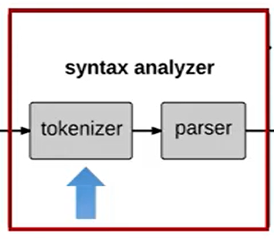

Syntax Analyzer
A component of a compiler that checks if the input code (a sequence of tokens) follows the grammatical rules of the programming language
Consists of
Tokenizer – Utilizes Lexical Analysis
Parser – Utilizes Syntax Analysis

Slide 66
Lexical Analysis
Pitch Deck
20xx
</
/>
} /> [
Writing the Tokenizer

Slide 67
What is This For?
The process of converting a sequence of characters into a sequence of tokens.
Writing the Tokenizer

Slide 68
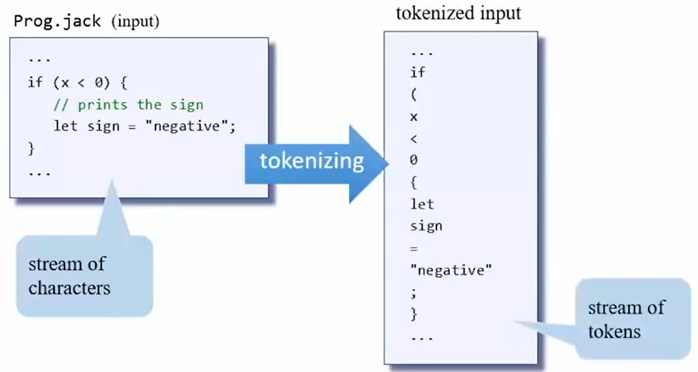
Tokenizer
Turns a stream of characters (compiler’s input) into tokens with an executable role or value
Token: a string of characters that has a meaning
Programming languages will include a list of allowed tokens

Slide 69
Tokens
Tokens are separated into types of tokens so that the repeat of a token type contains meaning (e.g. integer 1 followed by integer 0 results in integer 10).
Keywords (‘class’, ‘function’, ‘field’, ‘static’, ‘var’, ‘int’, ‘true’, ‘false’, ‘if’, ‘else’, ‘while’, ‘return’, etc.)
Symbols (‘ { ‘, ‘ } ’, ‘ / ’, ‘ ! ’, ‘ \ ’, ‘ : ’, ‘ ; ’, ‘ = ’, etc.)
Integers (‘0’, ‘1’, ‘2’, ‘3’, ‘4’, ‘5’, etc.)
Strings (“potato”, “RGB”, “Sunny”, “Fire”, “skull”, “emoji”, etc)
Identifiers (calculate_area, x, firstName, hello_there, Digital123)
A sequence of letters, digits, and underscore not starting with a digit

Slide 70
Grammars
Pitch Deck
20xx
</
/>
} /> [
What Gives Sequence of Tokens Meaning

Slide 71
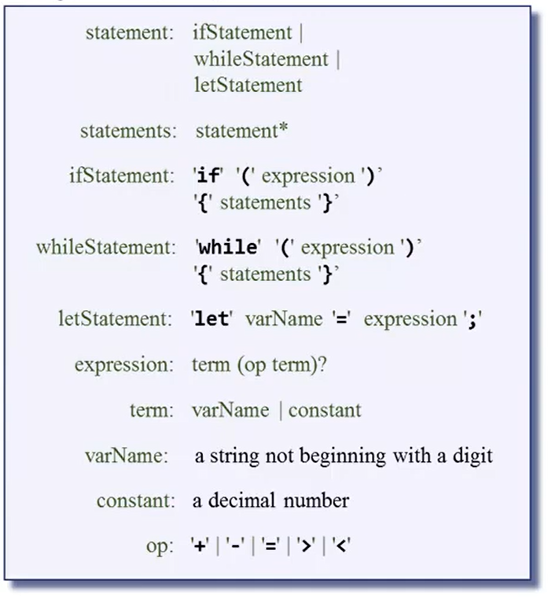
Grammar?
A set of rules that describes how token patterns should create valid logical instructions.
Rules consist of a template name (left-hand side) and a template composition (right-hand side).
Ex:
Input: let x = 100;
let → letStatement
x → term (varName)
= → operation symbol
100 → constant
; → expression

Slide 72
Parsing
Pitch Deck
20xx
</
/>
} /> [
What Gives Sequence of Tokens Meaning

Slide 73

Parsing
Determining if a given input conforms to a grammar
In the process, constructs the grammatical structure of the given input.

Slide 74
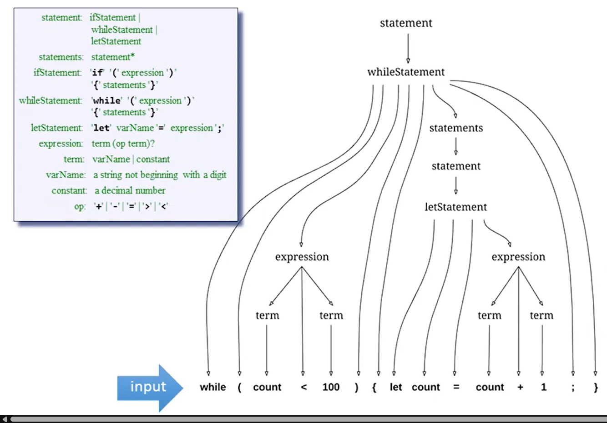
Parse Trees
A graphical layout detailing how a compiler’s input is systematically organized and broken down according to grammar rules.

Slide 75
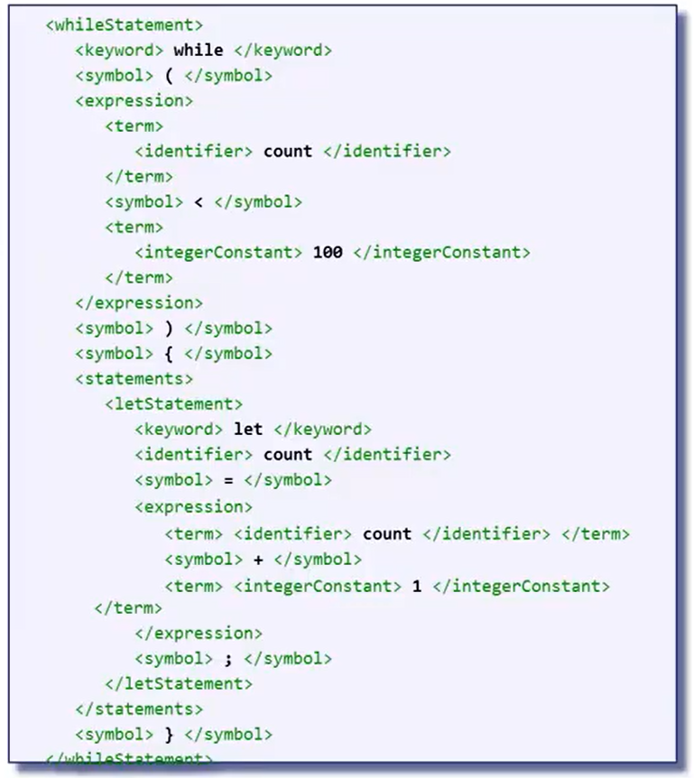
Parse Logic
Following the parsing, the output will look something like this.
This resembles what the syntax analyzer will output to the code generator.

Slide 76
Code Generator
Pitch Deck
20xx
</
/>
} /> [
Where the Magic Happens

Slide 77
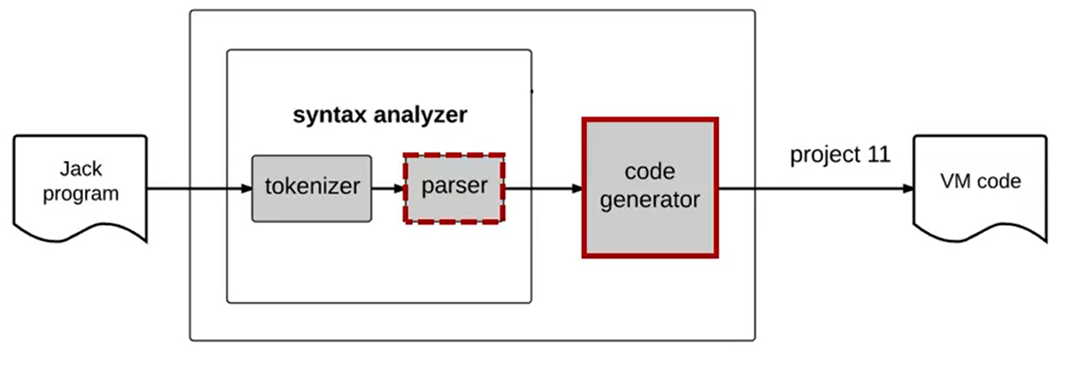
What is a Code Generator?
Code generators translate parsed code into VM code.
High-Level Program

Slide 78
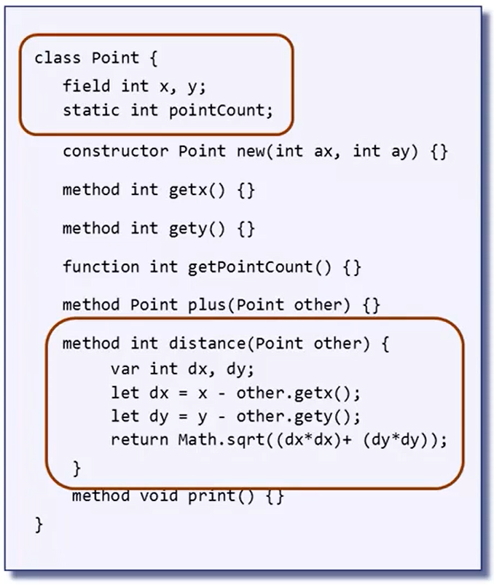
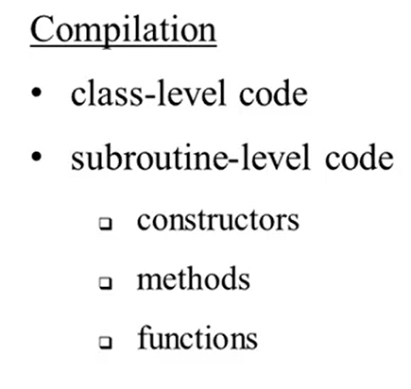
Class Separation
More complicated compilers can compile programs with multi-class code. In this compiler, the class is broken down into separate subroutines and compiled one at a time.
Subroutines:
A block of reusable code designed to perform a specific, common task, also known as a procedure, function, or method

Slide 79
Compiling Subroutines
You are handling
Procedural Code
Variables
Expressions
Flow of Control
Objects
Arrays
which are to be expressed in VM code

Slide 80
Procedural Code
Pitch Deck
20xx
</
/>
} /> [
Placeholder

Slide 81
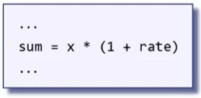
Handling Variables
VM Language does not have symbolic variables. In order to turn high-level language into VM code, you need to map the symbolic variables into the virtual memory segments.
sum, x, rate
Which segments do each of these belong to?
Challenges
Differentiate variables (are they field, static, local, or argument?)
Differentiate whether a variable is the first, second, third, … of its kind

Slide 82
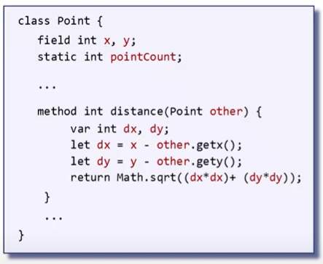


Variable Properties
To classify each variable, break each of them down by their properties.
Name
Type (int, char, boolean, etc.)
Kind (field, static, local, argument, etc.)
Scope (class level, subroutine level)
Variable properties can be maintained using a symbol table.
Class-Level Symbol Table
Subroutine-Level Symbol Table
Can reset after compiling a new class
Can reset after compiling a new subroutine

Slide 83





Handling Expressions
How can we systematically translate these expressions into VM code?
Notations:
Prefix
Operand goes before variables
Functional
Infix
Operand is in the middle of variables
Human-Oriented
Postfix
Operand goes after variables
Stack-Oriented
Parse Trees

Slide 84

Parse Tree to VM Code
Algorithm: Depth-First Tree Traversal
A two-stage approach
Starts at root (+) and pushes variables from left to right.
Problem: Parse Trees can be gigantic, making this algorithm quite slow for large expressions

Slide 85

Generating VM Code For Expressions (Faster)
Generates VM code without needing to create the entire parse tree in the process
Algorithm: Code Write
A one-stage approach
A series of conditions that directly convert the expressions into VM code

Slide 86

Problem: Flow of Control
Problem: How do you translate high-level language like this into VM code using just...?
goto
if-goto
label

Slide 87

Compiling If Statements
Using this sequence, it becomes possible that, given any if statement, the compiler will output exactly the same if statement.

Slide 88

Compiling While Statements
While statements are compiled as such.

Slide 89
Minor Complication
Problem: Complicated high-level programs will contain multiple if and while statements. How do we account for this?
Solution: Ensure that the compiler generates unique labels.
Problem: If and while statements are often nested
Solution: Compiler must use a highly recursive (repetitive) compilation strategy

Slide 90



Problem
High-Level object-oriented programs create and manipulate objects and arrays
Mid-Level VM program operate on virtual memory segments
Low-level machine programs operate directly on the RAM
How do you make compilers that write the necessary mid and low level automatically?

Slide 91
Handling Objects
Pitch Deck
20xx
</
/>
} /> [
Placeholder

Slide 92

Low-Level Aspects
There is a reserved space in the RAM called the “heap”. The heap exclusively stores the data of objects and arrays.
The base addresses “this” and “that” represent object and array data respectively.
Before we use the segments, we have to anchor them using pointers.
pointer 0 (this)
pointer 1 (that)

Slide 93


Object Construction
Compilers need to have end code that handles object construction. There are two classes needed to complete this: client and point.
Client: seeks to create a point object (caller)
Point: services the client’s request to create a point object (callee)
Includes a subroutine known as “constructor”
The compiler sees these two as separate compilation units.

Slide 94



Constructor Call
Variables of the high-level code are stored in the stack. A pointer is assigned to that stack, which contains a base address of where the objects are stored in the heap.
Upon variable declaration, the compiler updates the subroutine symbol table. (no code is generated)
Push arguments and call Point.new
Pop the base address of object being constructed
Compile-Time: Compiler maps p1 on local 0, p2 on local 1, and d on local 2.
Run-Time: Constructor’s code creates objects and allocates them to the heap.
The client assumes that the RAM will have space.

Slide 95


Compiling Constructors (Callee)
To complete the tasks previously mentioned, the constructor will need to have access to the constructor’s fields.
Fields are accessed in the “this” segment. To access the this segment, we have to anchor the segment with the right address in the RAM using the pointer segment.
Code needs to be created here
Constructor Declaration (creates subroutine symbol table)
Compiler uses the operating system to create space in the RAM reserved for calling an argument called Memory.alloc
Runs push and pop operations to use the new space in the RAM

Slide 96
Handling Arrays
Pitch Deck
20xx
</
/>
} /> [
Placeholder

Slide 97



Array Construction
Arrays exist as a subroutine class. The compiler will allocate additional space that represents the array in the heap.
The base address of the stack is stored in local 0.
Like how the “this” pointer is used for objects, the “that” pointer is used for arrays. Arrays also use pointer 1 instead of pointer 0.
Both “this” and “that” are “portable” virtual memory segments, meaning they can be aligned with different RAM addresses in the heap.

Slide 98


Array Access
Problem: A solution like this will overwrite the address written in pointer 1.
Incorrect

Slide 99



Array Access
Solution: This method correctly assigns pointers and avoid overwriting segments.
General Solution to Generate Code to Access Array

Slide 100
Standard Virtual Machine Mapping
Pitch Deck
20xx
</
/>
} /> [
Placeholder

Slide 101
Special OS Mapping
These are OS functions.
Multiplication: Math.multiply()
Division: Math.divide()
String Constants: String.new(length)
String Assignments: String.appendChar(c)
Object Construction: Memory.alloc(size)
Object Recycling: Memory.dealloc(object)

Slide 102
End of Meeting #3
[Loading...]
20xx
</
} /> [
Do you have any questions?
/>
Thanks for attending!
OS Team

Slide 103
04
Operating Systems
Pitch Deck
20xx
</>
} /> [

Slide 104
What is an Operating System?
WIP

Slide 105

OS Services
This high-level program has calls to methods highlighted in blue which exist in classes that belong to standard libraries that accompanies a programming language.

Slide 106


OS Typical Services
Operating systems typically benefit high-level programmers. They can expect access to:
Mathematical Calculations
Data Structures
Input Device Interaction
Write on the Screen
Low-level services include:
Manage and Host Memory
File Storage Management
Device Drivers Mitigation
User-Computer Communication
Multiple Processes
Communication Software
Security

Slide 107
Efficiency
Pitch Deck
20xx
</
/>
} /> [
Math Done Quicker

Slide 108



Multiplication
Run-Time: How long an algorithm takes to perform its task
N represents the largest number that way be asked to multiply with
Multiplication: Run-time is proportional to N
Multiply with w-bit number (w being the number of bits required to represent N)
w = log₂N
Inefficient
Efficient
Note: Only uses addition

Slide 109



Division
Division by Repetitive Subtraction: Run-time depends on input’s size
Another algorithm is based on long division
Run-time depends on number of digits
A better algorithm’s run-time is proportional to log₂N
N represents the largest number that way be asked to multiply with
Inefficient
Efficient
Long Division
Even More Efficient
Involves only addition operations

Slide 110

Square Root
Its inverse function (x²) is easily computable
It is a monotonically increasing function
Use a method called “binary search”
The run-time of binary search is logarithmic
Highly-Efficient

Slide 111
Memory Access
Pitch Deck
20xx
</
/>
} /> [
Placeholder

Slide 112
The Memory Class
Classical Operations:
Peek
  function int peek(int address)
Poke
  function void pook(int address, int value)
Alloc
  function array alloc(int size)
Dealloc
  function void deAlloc(Array o)

Slide 113
The Need
Application Programs
Programs can’t access RAM on their own. OS allows the programs to:
Access the RAM via abstractions: variables, objects, arrays, …
Access I/O Devices via abstractions: readInt(), printInt(x), …
Implementation:
OS provides low-level services that facilitate direct RAM access
Based on these low-level services, the OS features higher-level memory and I/O management services

Slide 114
Heap Management
Pitch Deck
20xx
</
/>
} /> [
Placeholder

Slide 115


The Challenge
During run-time, programs typically create many objects and arrays. Objects/arrays are implemented using reference variables and pointers to data blocks in the heap.
Problem:
How do you…
Allocate memory for new objects/arrays
Recycle memory of disposed objects/arrays

Slide 116


Object Construction
Operation:
High-level program creates an object variable
High-level program calls the constructor to build an object and associate point with p variable
Whenever a new object is needed, the constructor sends a request to the operating system to allocate space for the new object.

Slide 117

Object Destruction
When an object is no longer necessary, the disposer will recycle the memory block associated to the unnecessary object. This will free the space of data.
(In languages like Java and C#, they have a garbage collector, meaning deallocation of objects is handled automatically.)

Slide 118


Linked List (freeList)
Helps keep track of available heap segments
Keeps two overhead words that includes the size and a pointer to the next segment in the freeList
Allocation:
Search through the freeList until you find a block with enough size, then remove the segment from the freeList and hand its pointer to the caller
Deallocation:
Add the object segment to the end of the freeList

Slide 119
Graphics
Pitch Deck
20xx
</
/>
} /> [
Placeholder

Slide 120
The Screen Class
Handles all graphical operations of our programs
Library includes:
clearScreen()
setColor(boolean b)
drawPixel(int x, int y)
drawLine(int x1, int y2, int x2, int y2)
drawRectangle(int x1, int y2, int x2, int y2)
drawCircle(int x, int y, int r)

Slide 121

Techniques
Two Common Techniques are the “Vector Graphics” and the “Bitmap Graphics”

Slide 122


Bitmap Graphics
Records information about the image
Separate the graphics files by row. In each row, for every white pixel, output a 0. For every black pixel, output a 1.

Slide 123

Vector Graphics
Records instructions on how to produce image using coordinates.
Look at image in terms of row and column. Draw lines and rectangles using the least amount of instructions.
Basic Instructions:
drawLine(int x1, int y2, int x2, int y2)
drawRectangle(int x1, int y2, int x2, int y2)
drawCircle(int x, int y, int r)

Slide 124

Differences in Scaling
Vector graphics allow for perfect scaling when enlarging images. Because vectors use instructions, all that is needed is to proportionally increase its instructions.
Bitmap graphics look dull when scaled because no new information is added to the image. Retaining a fixed resolution means to scale the image, software needs to use algorithm like interpolation or average-color summing, which leads to a less detailed appearance.

Slide 125
Differences in Storing
Vector graphics contain relatively little information because they are instructions rather than information on each pixel. That also makes vector graphics easier to transmit.
Vector graphics can also be turned into bitmap graphics.

Slide 126
Textual Outputs
Pitch Deck
20xx
</
/>
} /> [
Placeholder

Slide 127


Character Set
Managed by the OS Class Output
Printable Characters
Contains a bitmap image representing characters that is displayed to the user
Non-Printable Characters
Contains information/instructions but no visual display
Displayed on a 256 by 512 pixels grid

Slide 128


Font
Words are displayed on a bitmap, specifically a 11 by 8 pixel grid
Each frame has 2 columns and 1 row of empty pixels for spacing.

Slide 129
Input
Pitch Deck
20xx
</
/>
} /> [
Placeholder

Slide 130


Keyboard Inputs
Part of the Keyboard class
The RAM includes a single 16-bit register for the keyboard map
Unique inputs are stored as separate base addresses in the RAM
Hardware Interaction:
When a key is pressed, the keyboard register outputs the scan code
When no key is pressed, the keyboard register resets the scan code to 0

Slide 131
String Processing
Pitch Deck
20xx
</
/>
} /> [
Placeholder

Slide 132
String API - Calls
Runs in the String class
Utilizes…
The constructor to create new strings with a defined max length
The disposer to deallocate the string and free memory space
An accessor that returns the length of the current string
API*: Application Programmable Interface
Used as IDs to pass along information

Slide 133
String API - Method Call
Methods
charAt: returns the character in a given string index
SetCharAt: ets a desired character of a string to a different character
appendChar: takes a character and appends it to end of string
eraseLastChar: erases last character from string
intValue: returns integer value of string (assuming it is an integer)
setInt: sets string to representation of given integer

Slide 134
String API - Function Call
Functions:
Function
newLine
backSpace
doubleQuote
These functions return the ASCII values of the new line

Slide 135

Integer to String Algorithms
While integers are more easily converted to strings, strings can only be converted to integers if the string consists of a numerical value.

Slide 136
Array Representation
Pitch Deck
20xx
</
/>
} /> [
Placeholder

Slide 137


The Array Class
Consists of 2 subroutines
new(int size): creates a new array of a given size
dispose(): disposes the selected array
“Array Processing” is handled by the compiler, not the operating system. The operating system is in charge of creating and disposing of arrays.

Slide 138
The Sys Class
Pitch Deck
20xx
</
/>
} /> [
Placeholder

Slide 139

The Sys Class
Consists of four methods (one is something users don’t get to see)
halt(): Halts execution
Not for users, but for the OS
error(int errorCode): Prints given error and halts
wait(int duration): Waits approximately duration in milliseconds and returns
init(): used strictly for OS services; performs all initializations required by the OS

Slide 140
Bootstrapping/Booting
The process of loading the basic software into the memory of a computer after power-on/reset. The operating system is included in the software loaded, which is then tasked with loading the other software as needed.

Slide 141
End of Meeting #4
[Loading...]
20xx
</
} /> [
Do you have any questions?
/>
Thanks for attending!
OS Team

Slide 142
The
Operating Systems Curriculum
Pt. 2: Linux
[Loading...]
20xx
</
} /> [
/>
By DIGITAL

Slide 143
What is Linux?
Linux is an open-source operating system built around the Linux kernel, a core component that manages hardware and system resources.
Advantages:
Open Source Software
  Being able to see how a software works allows you to research the source code and make improvements much easier
Command-Line Interface
  Allows the user to run all administrative tasks from the CLI, enabling easier automation, deployment, provisioning, and local/remote system administration
Modular Operating System
  System components can be upgraded and updated when needed

Slide 144
Linux Terminology
Linux Kernel:
Linux Distribution: an installable operating system that is constructed from a Linux kernel and that supports user programs and libraries

Slide 145
Linux Terminology
Linux Kernel:
Linux Distribution: an installable operating system that is constructed from a Linux kernel and that supports user programs and libraries

Slide 146








The adjustments are of higher concern, but optionally, these slides can also be improved by standardizing the structured “formats”. Standardization between similar types of info, or different topics of info, might enhance the slides, once all the important info is down

Slide 147






